Slide 1

UML Activity Diagram
Dr Rami Bahsoon
School of Computer Science
University of Birmingham, UK
r.bahsoon@bham.ac.uk

Slide 2
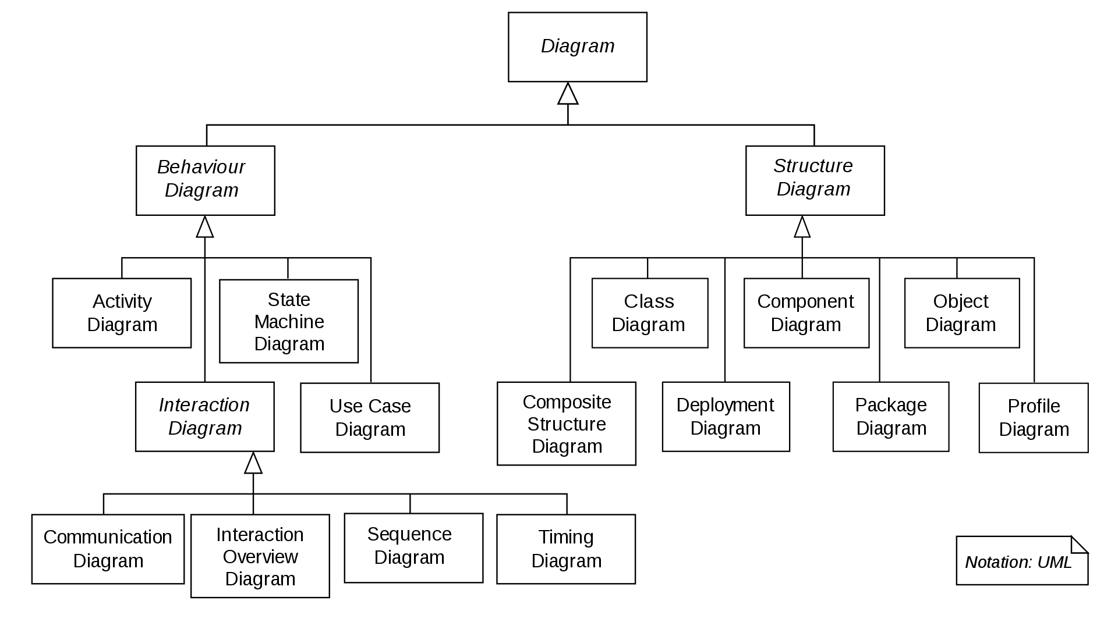
UML 2.X
UML 2.X
Collaboration Diagram

Slide 3
Activity Diagram
Activity diagrams are used to model (work)flows
Activity diagrams show the dependencies and coordination between activities within a system
The activity flow should not get “stuck”
help in identifying use cases of a system and operations involved in the realization of a use case and their behavior
Workflows and business processes
Can be attached to any model element to model its dynamic behavior
They can be used during the requirements elicitation process to understand concurrent and parallel behavior

Slide 4
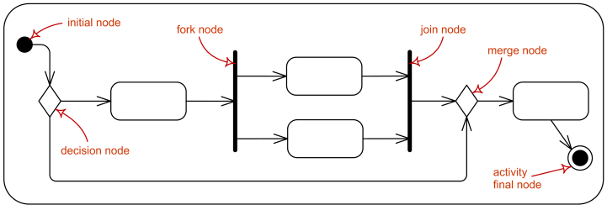
Activity Diagram Overview

Slide 5
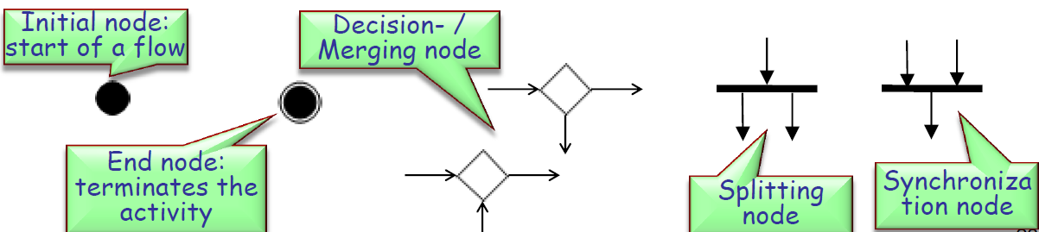
Elements of Activity Diagrams
Allows refinement
Activity: can contain activities, actions, control nodes. An activity is a sequence of actions.
Control nodes: used to denote control structure in the flowgraph
fork
join

Slide 6
Activity Diagram

Slide 7
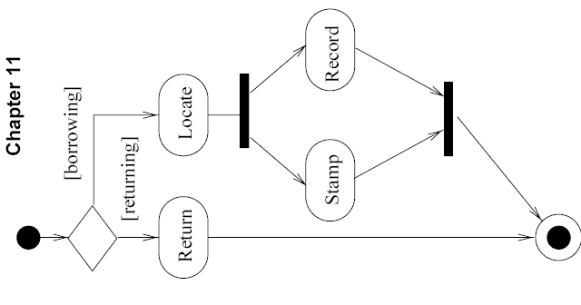
Activity Diagram

Slide 8
Activity Diagram
Swimlanes(i.e., main actors swimming on each lane)

Slide 9
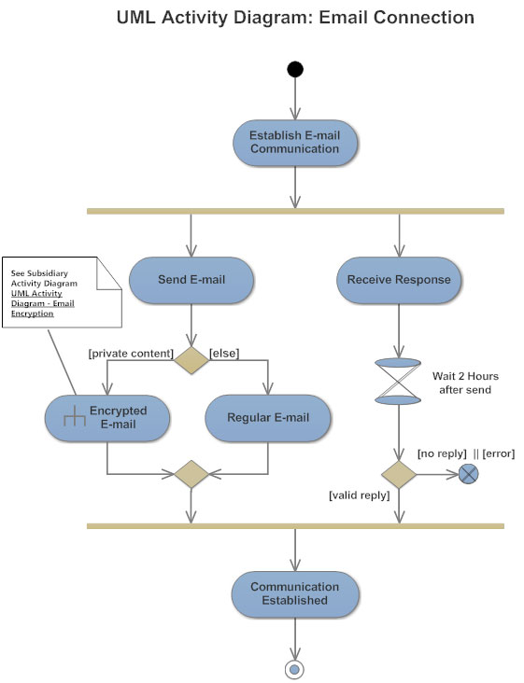
Time signal
Pointing to a sub-activity diagram (Zoom in)
Flow termination

Slide 10
When to Use Activity Diagram
A great tool for work flow and process modelling as they support and encourage parallel behaviour.
Take advantage of the forks and joins for concurrent programs.
An important technique to represent behavioural logic.
In many cases, it is used to describe a use case.

Slide 11

Exercise – online banking system
Overview of banking systems
SmartBank is an online banking system that allows the customer to perform all the available actions through an ATM screen. The system can also be accessed by bank staff to perform the actions through cashiers. The system should provide basic operations such as deposit money, withdraw money, transfer money and agree to make loans to their customers. The bank cashiers can create new bank accounts to customers, search for customers’ accounts, update/view customer personal details and close customers bank account.
Search account
<<extend>>
Withdraw
View details
<<extend>>
Update details
Deposit
Transfer
customers
Make loan
Cashier
Open account
Close account
Notes:
From last lecture

Slide 12
Withdraw Use Case Diagram
Assume:
Cashier will do the money withdrawing at the bank. You will give the card to the cashier
Card has been validated
Validate User
<<include>>
Login account
Choose option
Check Balance
<<include>>
Enter amount
customers
Enter other service
End transaction

Slide 13
Withdraw Cash Activity Diagram
Cashier
Display
Account
Activity Initial
Insert amount
Check balance
Display insufficient
amount
[Else]
[balance>=amount]
Get Money and
card
Update balance
Display success
Activity Final
Notes:
Assumption: Don’t need to login and just enter amount and get cash
You can always make it more detailed.

